Slide 1
Public Health Implications of Global Warming
Edward P. Richards, JD, MPH
Director, Program in Law, Science, and Public Health
Clarence W. Edwards Professor of Law
LSU Law School
richards@lsu.edu
http://biotech.law.lsu.edu
http://sites.law.lsu.edu/coast/
http://ssrn.com/author=222637

Slide 2
Climate Terms for this Talk
Weather is the short term variation of atmospheric conditions.
Climate is the average of weather over a set period, currently 20 years.
Climate change
  Increased variability
    Temperature
    Precipitation
    Wind
  Increased mean temperatures

Slide 3
Questions
Is the climate changing?
Does climate change threaten the public health?
Are extreme weather events due to climate change?
How must we change our disaster response and mitigation programs to better manage existing and evolving climate risks to the public health?

Slide 4
WHO and Climate Change

Slide 5
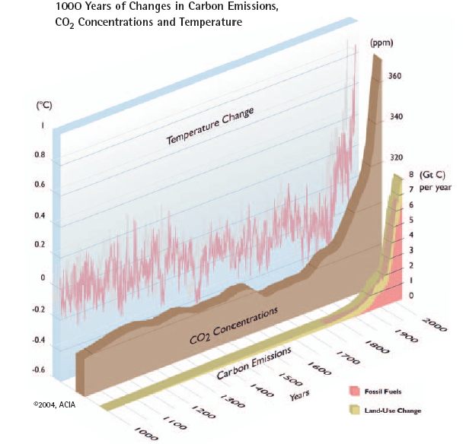

Temperatures are rising rapidly, following increases in CO₂ emissions and concentrations
Notes:
The three graphs on this chart show changes over the past 1,000 years. The bottom graph shows carbon emissions; the beige band shows emissions due to change in land use (such as deforestation to create agricultural land) and the pink band shows fossil fuel emissions. Fossil fuel emissions have increased dramatically since the Industrial Revolution.
The middle, beige graph shows increasing atmospheric CO₂ concentrations in response to increasing carbon emissions. The atmospheric concentration of CO₂ prior to the Industrial Revolution was approximately 280 ppm; the current concentration is nearing 390 ppm. This concentration has not been exceeded during the past 420,000 years and probably not during the past 20 million years.
The pink line shows that, although there has been variability, global average surface temperature has paralleled CO₂ concentrations for the past 1,000 years. The global average surface temperature increased approximately 0.7ºC during the past century, with about 0.4ºC of that increase since the 1970s. Temperatures are now changing at 0.18ºC per decade. Surface temperatures now exceed the upper limit of natural (historic) variability.
Image from ACIA (2004), reproduced with permission.
5

Slide 6
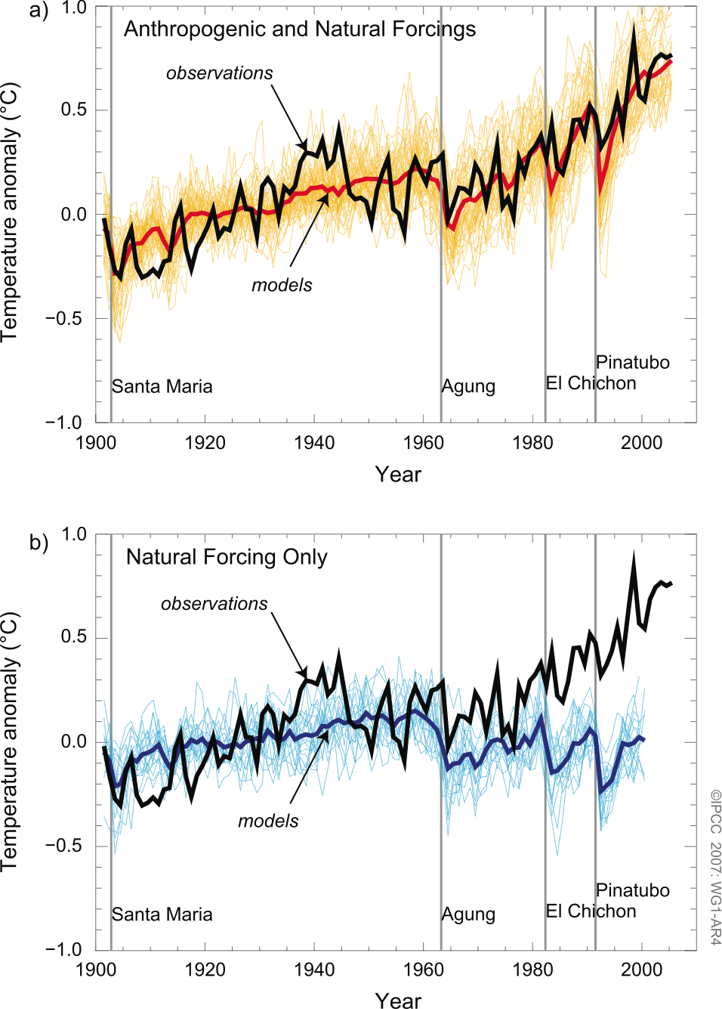
Temperature increases cannot be explained by natural processes
IPCC 2007: 4th assessment report
Notes:
6
Given that records show that climate is changing, the next question is the degree to which human activities are responsible.
The top figure shows global mean surface temperature anomalies relative to the period 1901 to 1950, as observed (black line) and from models that included anthropogenic and natural forcings. The thick red curve shows the means from the models and the thin lighter red curves show the individual model results. Vertical grey lines indicate the timing of major volcanic events.
The bottom figure shows global mean surface temperature anomalies relative to the period 1901 to 1950, as observed (black line) and from models that included only natural forcings. The thick blue curve shows the means from the models and the thin lighter blue curves show individual model results.
Image from IPCC 4th Assessment Report (2007)

Slide 7
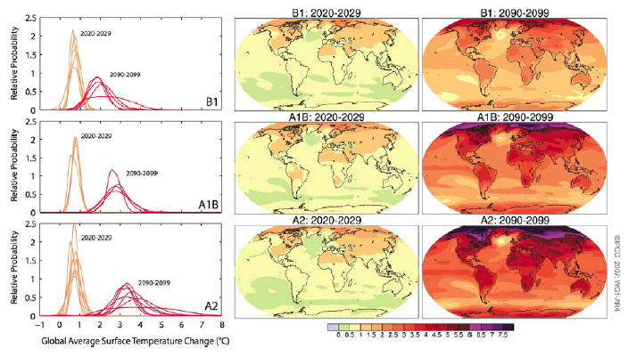
Temperatures will rise further
IPCC 2007
Notes:
These figures and maps show projected surface temperature changes for the early and late 21st century relative to the period 1980 to 1999. The left panel shows projections for the global average surface temperature for the next century. The central and right panels map projections of these values averaged over the decades 2020 to 2029 (center) and 2090 to 2099 (right).
Image from IPCC 4th Assessment Report (2007)
7

Slide 8
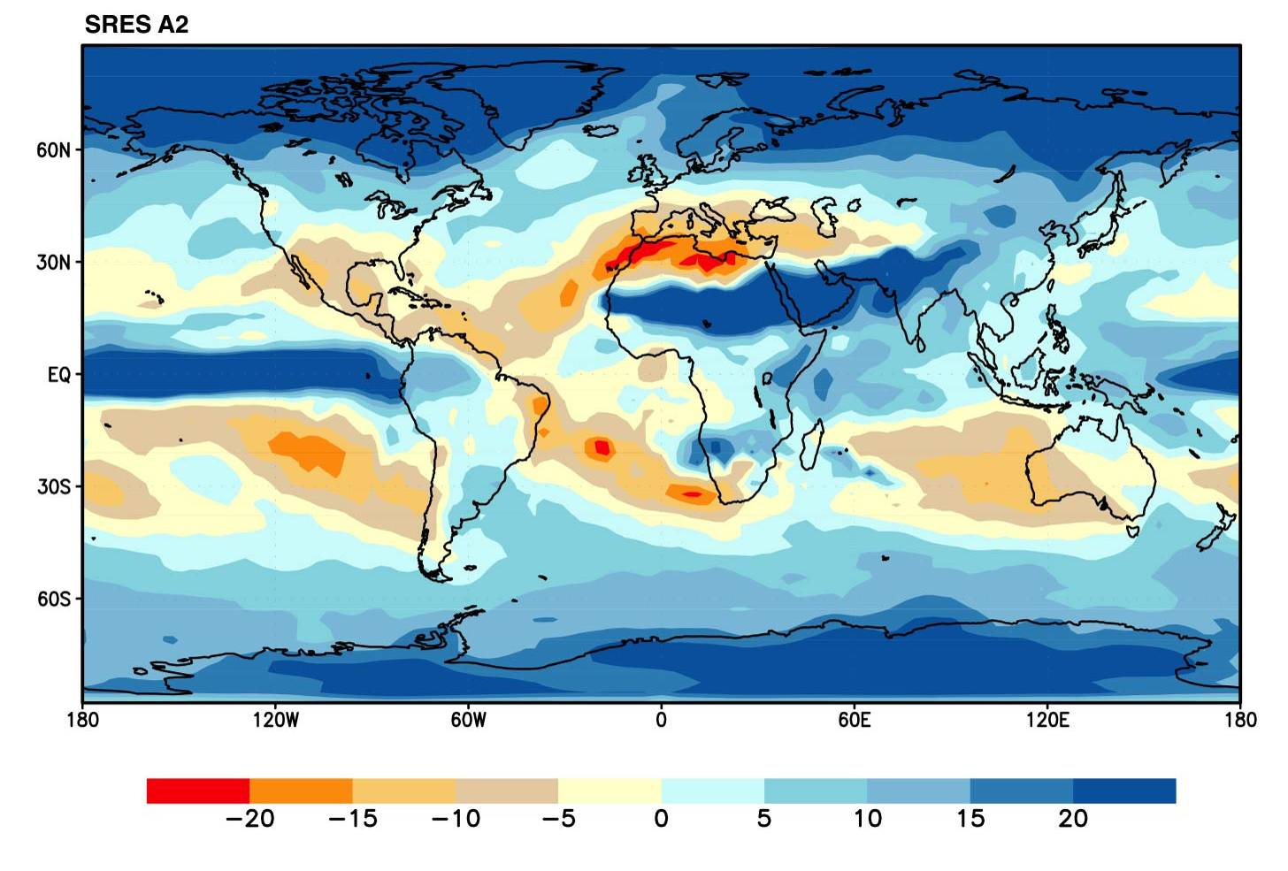
Precipitation will also change, and become more extreme
Annual mean precipitation change: 2071 to 2100 compared to 1990.
IPCC, 2007
Notes:
This map shows in more geographic detail changes in mean precipitation.
Image from IPCC 4th Assessment Report (2007)
8

Slide 9
Many aspects of weather have changed, and will continue to do so
IPCC 2007
Notes:
This summarizes the conclusions of the IPCC on observed and projected trends in various climatic events. These changes could have significant impacts on human health.
An asterisk in column D indicates that formal detection and attribution studies were used, along with expert judgment, to assess the likelihood of a discernible human influence.
Source: IPCC 4th Assessment Report (2007)
9

Slide 10
Climate change connects to many health outcomes
Some expected impacts will be beneficial but most will be adverse. Expectations are mainly for changes in frequency or severity of familiar health risks
Modulating
influences
Health effects
Temperature-related illness and death
Extreme weather- related health effects
Air pollution-related health effects
Water and food-borne diseases
Vector-borne and rodent- borne diseases
Effects of food and water shortages
Effects of population displacement
Human exposures
Regional weather
changes
Heat waves
Extreme weather
Temperature
Precipitation
Contamination
pathways
Transmission
dynamics
Agroecosystems,
hydrology
Socioeconomics,
demographics
CLIMATE
CHANGE
Based on Patz et al, 2000
Notes:
Reference: Patz, J.A., Engelberg, D. and Last, J., 2000. The effects of changing weather on public health. Annual Review of Public Health, 21: 271-307.

Slide 11
Some of the largest disease burdens
are climate-sensitive
Each year:
- Undernutrition kills 3.5 million.
- Diarrhoea kills 2.2 million.
- Malaria kills 900,000.
- Extreme weather events kill 60,000.
WHO estimates that the climate change that has occurred since the 1970s already kills over 140,000 per year.
Notes:
References for all figures given in WHO, 2009. Protecting Health From Climate Change: Connecting Science, Policy and People, World Health Organization, Geneva; page 7. http://www.who.int/globalchange/publications/reports/9789241598880/en/index.html
Image from CDC Public Health Image Library.

Slide 12
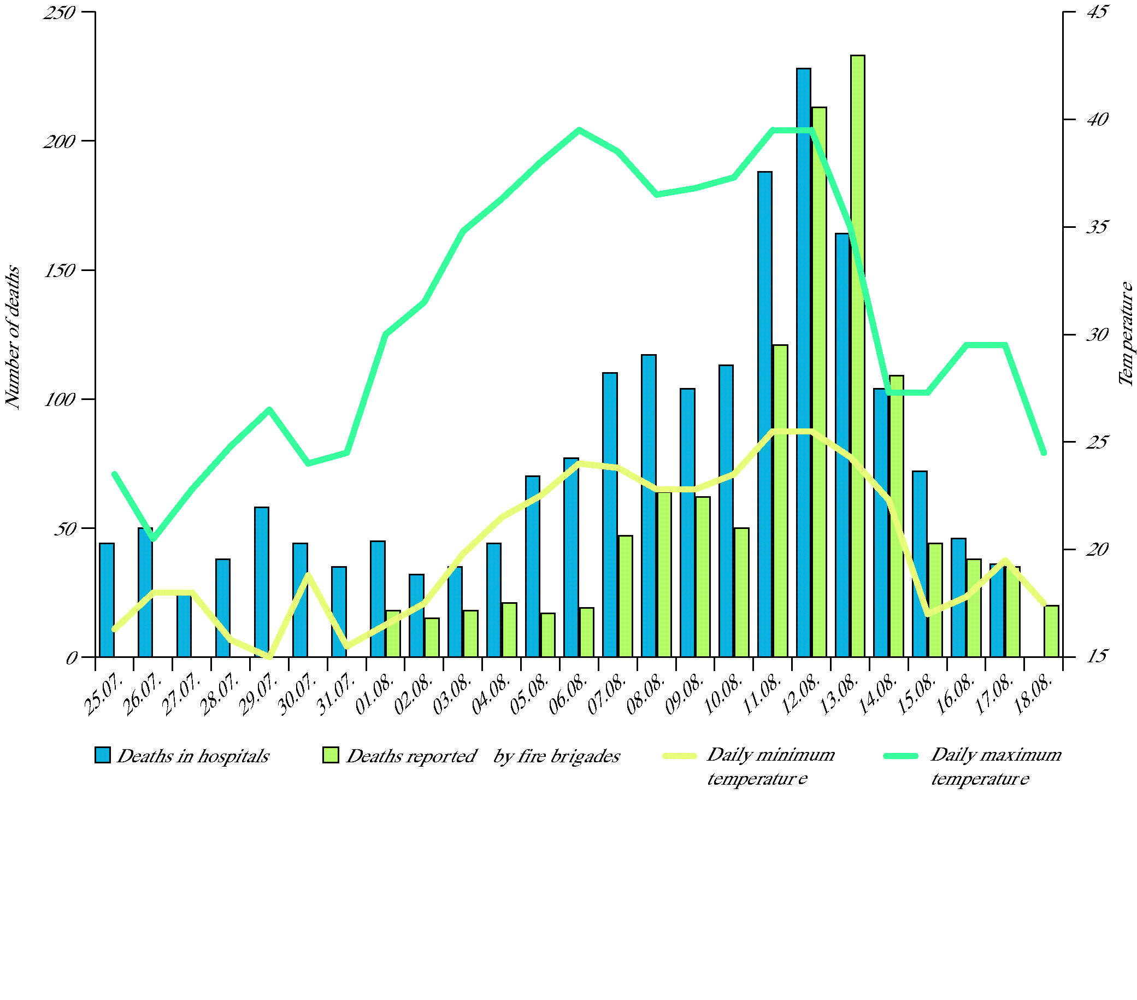
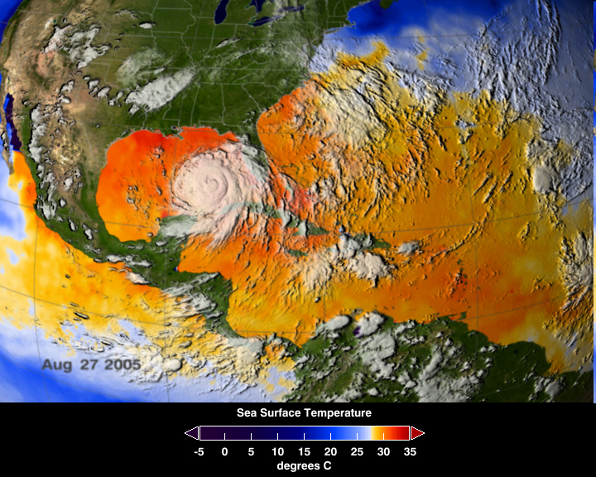
Weather-related disasters kill thousands in rich and poor countries
Deaths During Summer Heatwave. Paris Funeral Services (2003)
Hurricane Katrina, 2005
Notes:
References:
1) European Environment Agency: http://www.eea.europa.eu/data-and-maps/figures/number-of-reported-deaths-and-minimum-and-maximum-temperature-in-paris-during-the-heatwave-in-summer-2003 , based on data from IVS (2003): Impact sanitaire de la vague de chaleur en France survenue en aout 2003, Rapport d'etape, 29 aout 2003. Saint-Maurice, Institut de Veille Sanitaire.
2) NASA: http://www.nasa.gov/images/content/126421main_image_feature_398a_ys_full.jpg

Slide 13
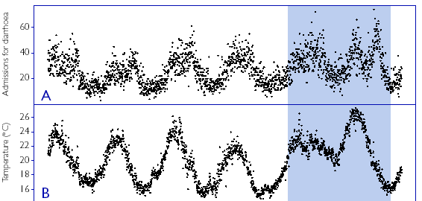

Increases in diseases of poverty
may be even more important
Diarrhoea is related to temperature and precipitation. In Lima, Peru, diarrhoea increased 8% for every 1⁰C temperature increase.
(Checkley et al, Lancet, 2000)
Notes:
Reproduced with permission from Elsevier/Lancet. Checkley, W. et al., 2000. Effects of El Nino and ambient temperature on hospital admissions for diarrhoeal diseases in Peruvian children. Lancet, 355(9202): 442-450.

Slide 14
Health impacts are unfairly distributed
Cumulative emissions of greenhouse gases, to 2002
WHO estimates of per capita mortality from climate change, 2000
Map projections from Patz et al, 2007; WHO, 2009.
Notes:
References:
McMichael, A. et al., 2004. Climate Change. In: M. Ezzati, A. Lopez, A. Rodgers and C. Murray (Editors), Comparative Quantification of Health Risks: Global and Regional Burden of Disease due to Selected Major Risk Factors. World Health Organization, Geneva.
Patz, J., Gibbs, H., Foley, J., Rogers, J. and Smith, K., 2007. Climate Change and Global Health: Quantifying a Growing Ethical Crisis. Ecohealth, 4: 397–405.
WHO, 2009. Protecting Health From Climate Change: Connecting Science, Policy and People, World Health Organization, Geneva.

Slide 15
Is The WHO Being Alarmist?

Slide 16
Is Climate Change Unusual?
Climate has varied over a huge range through geologic time.
There has been significant variation over historical time, including the Little Ice Age, from the 16th to 19th centuries.
In the longer term, the earth has been warming since the last real ice age, 11,000 years ago.
The key question is the extent of current warming due to greenhouse gas forcing.

Slide 17
What We Know for Sure
The ocean is a thermometer and it is has been going up (rising) for a couple of hundred years.
Greenhouse gases, primarily CO₂, have been rising during this period, consistent with the use of fossil fuel.
The current rise in temperature is not being driven by solar radiation or orbital variations.

Slide 18
What We Do Not Know for Sure
The rate of future temperature rise.
  Positive feedback from mobilizing peat and ocean methane.
  Negative feedback from clouds.
The rate of future ocean rise.
  Dependent on temperature, but lagging.
  Will the Greenland and Antarctic ice sheets break up faster or slower than the simple temperature model predicts?

Slide 19
Climate Change and Extreme Weather Events
More energy and moisture in the atmosphere increases variability everywhere
  Floods
  Droughts
  Heat events
Geographic shifts in weather
  Stronger and more frequent hurricanes in northern latitudes
  Heat and drought in temperate and equatorial areas
  Longer growing seasons in the north

Slide 20
Extreme Weather and Health
Floods
  Drowning, disruption of infrastructure
  Creation of refugees with attendant health and mental health effects
Heat stress
  Urban centers and the elderly
  Northern areas that are unprepared
  Forest fires
  Peat fires

Slide 21
Ecosystem Effects and Disease
Vector-pathogen-host relationships change
  Malaria, Dengue, tickborne illnesses, schistosomiasis
  Vectors become invasive in new areas
Tropical diseases zones expand
  New populations are not resistant
  Cultural habits may potentiate disease spread
Food and Water-borne illness expands

Slide 22
Climate Change is Only One Factor in Disease Spread
For Dengue, for example, housing density, zoonotic (monkey) hosts, air conditioning, water sources, etc. are critical.
  While the US has the mosquitoes, it does not have much Dengue any more.
  Researchers in Australia worry that creating water storage tanks for droughts could increase the breeding areas for the mosquitoes that carry Dengue.
Drought and famine will potentiate the morbidity and mortality of all diseases.

Slide 23
Ecosystem Effects and Food
Crop failures from drought and flooding
Reduced livestock production
Impairment of fisheries
  Destruction of coastal wetlands from levees
  Ocean acidification
Greatest impact in equatorial and lower temperate areas

Slide 24
Can We Mitigate Climate Change?
Reducing greenhouse gasses
  Atmospheric residence time creates hysteresis.
  The U.S. does not provide leadership.
  Everyone in China, India, and Africa wants a life that requires more energy.
Geoengineering
  Aerosols / Carbon sinks
  Not a good bet for a long time, if ever.

Slide 25
Can We Adapt to Climate Change?
With proper action, wealthy countries can mitigate the impact of climate change and the existing climate extremes.
At risk poor countries, especially those without functional governments, will likely be destabilized.
  Threats to the global economy.
  Potential nuclear and other terrorist threats.
  Whether we can/will help is an open call.

Slide 26
Adapting to the Once and Future Climate

Slide 27
The Risks of the Current Climate
Current extreme weather events cannot be proven to be due to climate change.
  Too soon to sort trends from the noise.
Yet extreme weather driven catastrophes have become much more common over the past 50 years.
  Floods
  Droughts
  Heat waves
What is happening?

Slide 28
Is it a Flood if Nobody Washes Away?
There are no catastrophic weather events in nature.
  Fire climax forests
  Hurricane climax coastal marshes
  Delta building through flooding
Extreme weather events only become catastrophes when they affect people
  The more people at risk, the more catastrophes.

Slide 29
We Underestimate the Weather
Extreme weather events are more common than the public assumes.
  The Gulf and Atlantic Coasts have a long and devastating hurricane history
  Katrina was not the first hurricane to flood New Orleans.
  Fukushima is a reminder of the cost of underestimating risk.
The federal and state governments systematically undermine risk communication.

Slide 30
We Migrate to Risk
Most major cities are on a coast or river.
  Over the past 50 years, there has been a large migration to high risk flood areas.
Suburbs have expanded into fire climax forested areas.
More expensive, less well constructed housing increases losses.
  The Green Building dilemma.

Slide 31
Stupidity Kills
Hurricane Betsy in 1965
  Flooded New Orleans / Killed 76 people
Post-Betsy Disaster Planning
  National Flood Insurance Program
  Ring levee system in the New Orleans Area
Hurricane Katrina in 2005
  1000-3500 Deaths
  About the same flooding, but people stayed and the water did not drain out.
Wonder what next time will look like?

Slide 32
We Have Made Stupidity Good Business
The National Flood Insurance Program
  Subsidizes high risk development
The Stafford Act and FEMA
  Rewards bad land use decisions
  Assures that high risk areas will be rebuilt even better than before
  Increased use of state and presidential disaster declarations.
We have greatly reduced incentives to mitigate risk by making disasters profitable.

Slide 33
Moving to Better Climate Change Decisionmaking

Slide 34
End Denial
Uncertainty about rates and causal factors is used to deny climate change.
  Greenhouse gas producers
  Parties who profit from unsound development.
Shift the question to properly adapting to the current climate.
  Demographic shifts and unsound development create the same risks as climate change.

Slide 35
Do Not Subsidize Risky Behavior
Subsidies block risk communication
  NFIP was meant to protect existing structures and stop new high risk development.
  FEMA and the Stafford Act have become redevelopment programs.
  State high risk insurance companies.
  Federal all hazards insurance
Internalize the cost of risky decisions.

Slide 36
Admit that Disaster Response is the Wrong Focus.
Response is cheap, you do not need to spend much until there is a disaster.
Response plans convey the idea that everyone will be taken care of after the disaster.
  This is impossible in a large scale disaster.
  People’s lives will be ruined and some will be lost.
Be honest about the limitations of response.

Slide 37
Don’t use Federal Money to Recreate Risk
Don’t encourage the romance of place
  The “right of return” in New Orleans.
  Celebrating people who rebuild in the same place as heroes.
Require communities to have a Plan B
  How they will reduce risk after a disaster by restructuring the community.
  Require community buy-in.
Use disaster relief to implement Plan B.

Slide 38
Don’t Forget the Poor
The government needs to provide incentives and help to get the poor out of high risk areas and to make them more resilient.
Failing to do so will let the poor be used as a weapon to resist change.

Slide 39
Bibliography
Anthony McMichael, et al., Climate change and human health: present and future risks, 367 Lancet 859 (2006).

